Slide 1
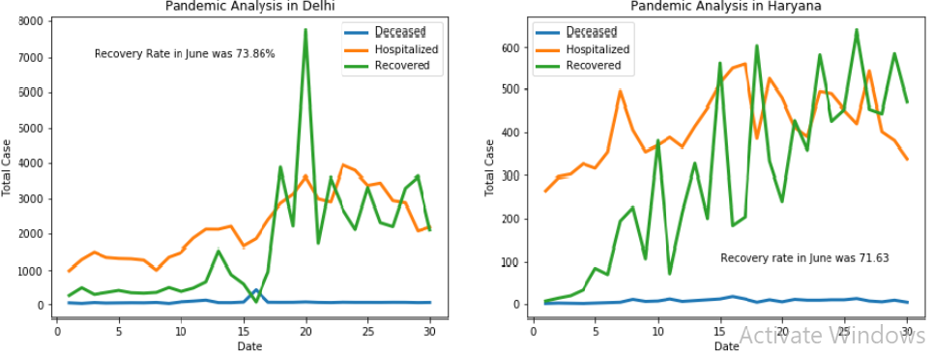
Minor Project on detailed overview on covid 19 for the state in the month of june 2020

